Slide 1
Deletion in AVL Tree
There are 5 cases to consider.
Let us go through the cases graphically and determine what action to take.
We will not develop the C++ code for deleteNode in AVL tree. This will be left as an exercise.

Slide 2
Lecture No.24
Data Structure
Dr. Sohail Aslam

Slide 3
Deletion in AVL Tree
Case 1a: the parent of the deleted node had a balance of 0 and the node was deleted in the parent’s left subtree.
Delete on this side
Action: change the balance of the parent node and stop. No further effect on balance of any higher node.
Notes:
Start of lecture 24

Slide 4
Deletion in AVL Tree
Here is why; the height of left tree does not change.
4
0
2
6
1
1
3
5
7
2

Slide 5
Deletion in AVL Tree
Here is why; the height of left tree does not change.
4
0
4
2
6
1
2
6
1
3
5
7
2
3
5
7
remove(1)

Slide 6
Deletion in AVL Tree
Case 1b: the parent of the deleted node had a balance of 0 and the node was deleted in the parent’s right subtree.
Delete on this side
Action: (same as 1a) change the balance of the parent node and stop. No further effect on balance of any higher node.

Slide 7
Deletion in AVL Tree
Case 2a: the parent of the deleted node had a balance of 1 and the node was deleted in the parent’s left subtree.
Delete on this side
Action: change the balance of the parent node. May have caused imbalance in higher nodes so continue up the tree.
Notes:
End of lecture 23.

Slide 8
Deletion in AVL Tree
Case 2b: the parent of the deleted node had a balance of -1 and the node was deleted in the parent’s right subtree.
Delete on this side
Action: same as 2a: change the balance of the parent node. May have caused imbalance in higher nodes so continue up the tree.

Slide 9
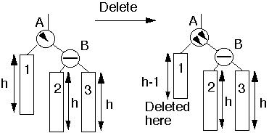
Deletion in AVL Tree
Case 3a: the parent had balance of -1 and the node was deleted in the parent’s left subtree, right subtree was balanced.

Slide 10
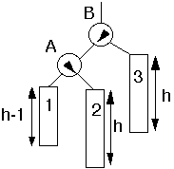
Deletion in AVL Tree
Case 3a: the parent had balance of -1 and the node was deleted in the parent’s left subtree, right subtree was balanced.
Single rotate
Action: perform single rotation, adjust balance. No effect on balance of higher nodes so stop here.

Slide 11
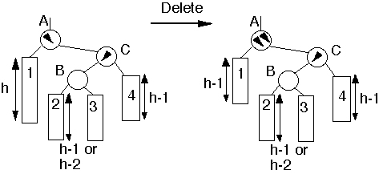
Deletion in AVL Tree
Case 4a: parent had balance of -1 and the node was deleted in the parent’s left subtree, right subtree was unbalanced.

Slide 12
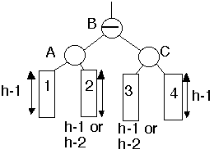
Deletion in AVL Tree
Case 4a: parent had balance of -1 and the node was deleted in the parent’s left subtree, right subtree was unbalanced.
double
rotate
Action: Double rotation at B. May have effected the balance of higher nodes, so continue up the tree.

Slide 13
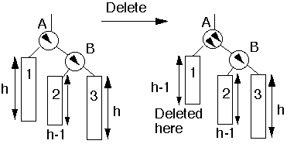
Deletion in AVL Tree
Case 5a: parent had balance of -1 and the node was deleted in the parent’s left subtree, right subtree was unbalanced.

Slide 14
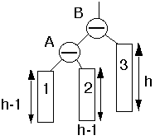
Deletion in AVL Tree
Case 5a: parent had balance of -1 and the node was deleted in the parent’s left subtree, right subtree was unbalanced.
single
rotate
Action: Single rotation at B. May have effected the balance of higher nodes, so continue up the tree.

Slide 15
Other Uses of Binary Trees
Expression Trees

Slide 16
Expression Trees
Expression trees, and the more general parse trees and abstract syntax trees are significant components of compilers.
Let us consider the expression tree.

Slide 17
Expression Tree
(a+b*c)+((d*e+f)*g)
+
+
*
a
*
+
g
b
c
*
f
d
e

Slide 18
Parse Tree in Compiler
A := A + B * C
<assign>
<id>
:=
<expr>
A
<expr>
+
<term>
<term>
<factor>
<term>
*
<factor>
  Expression grammar
  <assign> → <id> := <expr>
  <id> → A | B | C
  <expr> → <expr> + <term> | <term>
  <term> → <term> * <factor> | <factor>
  <factor> → ( <expr> ) | <id>
<id>
<factor>
<id>
A
<id>
C
B

Slide 19
Parse Tree for an SQL query
Consider querying a movie database
Find the titles for movies with stars born in 1960
The database has tables
StarsIn(title, year, starName)
MovieStar(name, address, gender, birthdate)
SELECT title
FROM StarsIn, MovieStar
WHERE starName = name AND birthdate LIKE ‘%1960’ ;

Slide 20
SQL Parse Tree
< Query >
SELECT <SelList> FROM <FromList> WHERE <Condition>
<Attribute> <RelName> , <FromList> AND
title StarsIn <RelName>
MovieStar
<Condition> <Condition>
<Attribute> = <Attribute> <Attribute> LIKE <Pattern>
starName name birthdate ‘%1960’

Slide 21
Compiler Optimization
Common subexpression:
(f+d*e)+((d*e+f)*g)
+
+
*
f
*
+
g
d
e
*
f
d
e

Slide 22
Compiler Optimization
(Common subexpression:
(f+d*e)+((d*e+f)*g)
+
+
*
f
*
g
d
e
Graph!
Notes:
End of lecture 24.

